Slide 1
HealthCheck Step-By-Step Guide
Benefits
FY2019

Slide 2
Protects Your Privacy
BlueCross BlueShield of Tennessee protects your health information, including your biometrics, so that it is only used to provide you with HealthCheck program services and assist BCBST in administering your medical plan.
As a part of the TVA group health plan, HealthCheck information is protected by two federal
laws, the Privacy Act and the privacy and security rules of the Health Insurance Portability
and Accountability Act (HIPAA). Detailed information is available on the Privacy page of the
Employee Benefits Website.
Notes:
Tips:
Slide title should be Arial font, 32 points
Title should be kept short and on a single line if at all possible
To change the image, right click on it and click Change Picture.

Slide 3
Where Do I Find Information About HealthCheck?
Go to: The Employee Benefits Website on TVA Today
Click on: Your Health Count$
Choose: HealthCheck
Notes:
Tips:
Slide title should be Arial font, 32 points
Title should be kept short and on a single line if at all possible
To change the image, right click on it and click Change Picture.

Slide 4
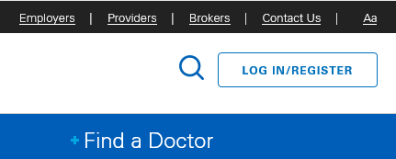
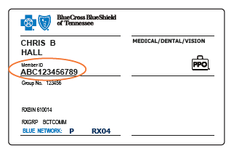
Register with BlueAccess
To register with BlueAccess, you will need the following information:
BCBST Subscriber ID (found on your BCBST
medical or wellness only ID card)
Group number (located below your Member ID on your medical or wellness only ID card.)
Date of birth
Subscriber zip code
Notes:
Tips:
Slide title should be Arial font, 32 points
Title should be kept short and on a single line if at all possible
To change the image, right click on it and click Change Picture.

Slide 5
Attestation, Proof, And Audit
No points will be awarded until you complete the Attestation Agreement.
Completion of this agreement states
that you certify the accuracy of the self-reported information you enter is true and correct.
The information you provide is subject to audit.
You must retain documentation where applicable for a period of two years.
Notes:
Tips:
Slide title should be Arial font, 32 points
Title should be kept short and on a single line if at all possible

Slide 6
Get Your Health Risk Measurements
Schedule your annual preventative physical with your physician to get the following health risk measurements:
Blood Pressure
HDL Cholesterol
LDL Cholesterol
Triglycerides
Fasting Blood Glucose*
Waist Circumference or BMI
No forms are necessary!
Do not eat or drink for 8-10 hours prior to your appointment. Water and one cup of black coffee is allowed. Make sure to take all prescription medications as directed.
DO NOT COMPLETE YOUR PERSONAL HEALTH ASSESSMENT WITHOUT THESE MEASUREMENTS!
*If you are unable to fast, due to restrictions by your physician, please see the alternative glucose measurement on the BlueHealth Rewards portal that does not require fasting.
Notes:
Tips:
Slide title should be Arial font, 32 points
Title should be kept short and on a single line if at all possible
To change the image, right click on it and click Change Picture.

Slide 7
Taking Your Personal Health Assessment
Go to www.bcbst.com and login to BlueAccess.
*If you don’t already have an account, see the instructions listed under “Register Now.”
Click on the “Managing Your Health” tab
Select the “Member Wellness Center” option
Click “Get Started Now”
No forms are necessary!
For assistance with the portal, please contact BCBST at 1-800-245-7942.
Choose the option for HealthCheck.
Notes:
Tips:
Slide title should be Arial font, 32 points
Title should be kept short and on a single line if at all possible
To change the image, right click on it and click Change Picture.

Slide 8
Get It Right The First Time
Do NOT complete the Personal Health Assessment without your biometric measurements!
Double check your data before you click “submit.”
Point values will be awarded based on the first values that you enter. You will not have the opportunity to change/correct your data once you submit it.
Improvements in your health, due to health actions, will be accounted for in other areas of the portal.
Notes:
Tips:
Slide title should be Arial font, 32 points
Title should be kept short and on a single line if at all possible

Slide 9
First Time Participants
Participants who complete the Personal Health Assessment for the first time will receive a $50 credit!

Slide 10
Biometric View
Upon completion of your Personal Health Assessment, the portal provides an easy to understand view of your biometric data.
Your personalized portal records and displays current/historical values for weight, BMI, waist circumference, blood pressure, pulse, glucose, total cholesterol, HDL, and LDL.
It also compares values to BCBST clinically recommended ranges.
Notes:
Tips:
Slide title should be Arial font, 32 points
Title should be kept short and on a single line if at all possible
To change the image, right click on it and click Change Picture.

Slide 11
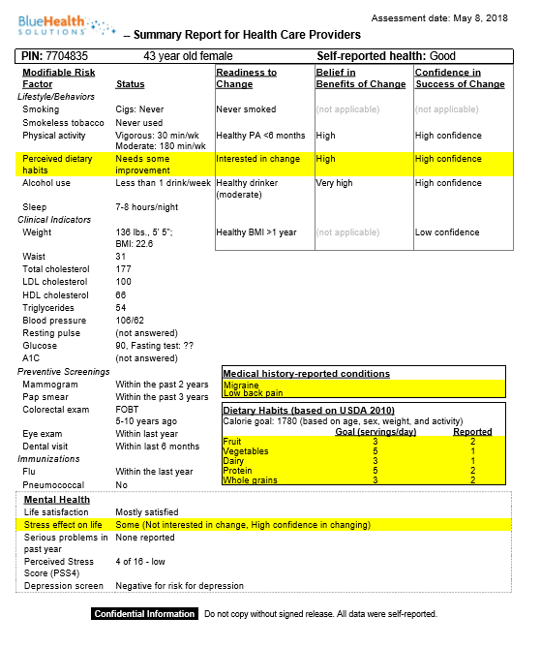
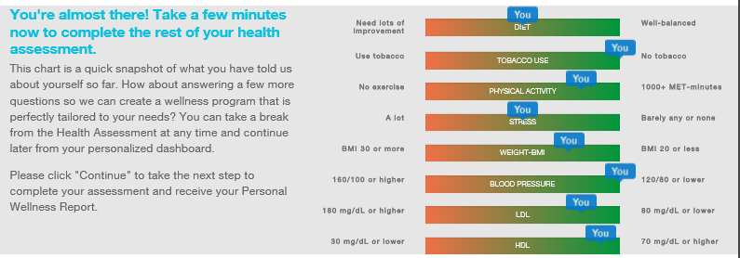
Member Wellness Center
Notes:
Tips:
Slide title should be Arial font, 32 points
Title should be kept short and on a single line if at all possible
To change the image, right click on it and click Change Picture.

Slide 12
Points Matrix
How many points do I need in order to receive my full $600 benefits credit?
A minimum of 190 points is required by midnight, ET, on September 15th, in order to receive the full $600 benefits credit.
Point Total | Benefits Credit
< 109 | $50
110-159 | $200
160-189 | $400
190 | $600
Can I earn a partial benefits credit?
No forms are necessary!
Yes. Partial benefit credits are assigned as listed on the matrix to the right.
Notes:
Tips:
Slide title should be Arial font, 32 points
Title should be kept short and on a single line if at all possible
To change the image, right click on it and click Change Picture.

Slide 13
Point Opportunities
In addition to the points earned by completing your Personal Health Assessment, you can also earn points by completing one or all of the health actions listed below:
Annual Preventative Exams
Preventative Exam | 20 points | 1 exam per year
Vision Exam | 20 points | 1 exam per year
Coaching/Condition Programs
Health Coaching | 25 points per session | Maximum: 100 points per yr
Chronic Condition Management | 25 points per session | Maximum: 100 points per yr
Case Management | 25 points per session | Maximum: 100 points per yr
PhysicianNow Registration | 10 points | For new registrations only

Slide 14
Additional Point Opportunities
Physical Activity
Step Counting Device/App Sync | 10 points for 150,000 steps per month | Maximum: 100 per yr
Activity Data – Self Reported | 10 points for 10 reports per month | Maximum: 100 points per yr
Fitness Blue Participation | 10 points for 10 visits per month | Maximum: 10 points per yr
Minor Event | 10 points per event | Maximum: 20 points per yr
Major Event | 20 points per event | Maximum: 40 points per yr
Blood Donation | 5 points per donation | Maximum: 20 points per yr
Coaching/Condition Programs
TVA On-Site Challenges | 20 points per challenge | Maximum: 80 points per yr
Lunch and Learn Webinars | 5 points per webinar | Maximum: 25 points per yr
BCBST Online Health Education | 5 points per course | Maximum: 20 points per yr
Online BCBST Quizzes | 5 points per quiz | Maximum: 20 points per year
Click here for short descriptions of each opportunity

Slide 15
2019 Challenges
Sleep Challenge – January
Log a minimum of 7 hours of sleep for 20 nights in the month of January.
TVA Fitness Challenge – July
1st Annual Team Event
Log a minimum of 30 minutes of activity for 20 days in the month of June
3rd Annual Step It Up Challenge – April
Obtain 200K steps or 1000 minutes of activity in the month of April
3rd Annual You Go With H2O Challenge - August
Log a minimum of 62 ounces of water for 20 days in the month of August
Notes:
Tips:
Slide title should be Arial font, 32 points
Title should be kept short and on a single line if at all possible
To change the image, right click on it and click Change Picture.

Slide 16
Communications
Be on the lookout for emails, TVA Today Articles, and fliers containing information about HealthCheck, your point progression, and additional point earning opportunities.
Check out the Wellness Calendar located on the Employee Benefits Website for important HealthCheck event dates and deadlines.
Notes:
Tips:
Slide title should be Arial font, 32 points
Title should be kept short and on a single line if at all possible
To change the image, right click on it and click Change Picture.

Slide 17
Where To Go For Help
For assistance with the BlueHealth Rewards portal or incentives, contact BCBST Customer Service at 1-800-245-7942
Login assistance
Navigation
Data entry assistance
No forms are necessary!
For questions related to HealthCheck, see the Employee Benefits Website
Basic processes
FAQ’s
Notes:
Tips:
Slide title should be Arial font, 32 points
Title should be kept short and on a single line if at all possible
To change the image, right click on it and click Change Picture.

